Slide 1
Data!
Organizing, Visualizing, & Sampling

Slide 2
Types of Data: Categorical / Qualitative
Labels / Categories
Nominal if labels have no order / ranking
Examples: Major, gender, nationality, political party, hair color
Ordinal if labels have order / ranking
Examples : Grades (A, B, C…), Place (1st, 2nd, 3rd…), Education level (High School, Undergrad, Graduate), Scales 1-10*
Can have numeric labels, but they are still labels, not quantitative data upon which math can be done - 2nd place isn’t 5x better than 10th - KEY DISTINCTION IS THAT INTERVALS MAY NOT BE EQUAL

Slide 3
Variable Types & Measurement Scales - Qualitative / Categorical
Nominal: Labels, unordered
Ex: Major (Engineering, Art, History, Economics)
Ordinal: Labels, ordered
Ex: Rank: (1st, 2nd, 3rd), Grades: (A, B, C…), Education Level (Elementary, Middle, High…)
Can have numeric labels, but they are still labels, not quantitative data upon which math can be done - 2nd place isn’t 5x better than 10th AND the gap
Also intervals are likely unequal. Distance between 1st and 2nd place may be way different than 2nd and 3rd place, even though both are 1 rank apart.

Slide 4
Organizing One Categorical Variable
Summary Table: A table tallying frequencies or percentages
Used for a single categorical variable
Favorite Class | Total / Frequency | Percentage
Applied Business Statistics | 25 | 83.33%
Managerial Economics | 5 | 16.66%
Poetry | 0 | 0%
Total | 30 | 100%

Slide 5
Organizing Two Categorical Variables
Contingency Table: A table showing the joint frequencies / percentages of two variables
 | Sedan | Truck | SUV | Total
Red | 2 | 1 | 4 | 7
Black | 3 | 2 | 4 | 9
Blue | 4 | 3 | 4 | 11
Total | 9 | 6 | 12 | 27

Slide 6
Organizing Two Categorical Variables
Contingency Table: A table showing the joint frequencies / percentages of two variables
 | Sedan | Truck | SUV | Total
Red | 2/27 = 7.4% | 1/27 = 3.7% | 4/27 = 14.8% | 7/27 = 25.9%
Black | 3/27 = 11.1% | 2/27 = 7.4% | 4/27 = 14.8% | 9/27 = 33.3%
Blue | 4/27 = 14.8% | 3/27 = 11.1% | 4/27 = 14.8% | 11/27 = 40.7%
Total | 9/27 = 33.3% | 6/27 = 22.2% | 12/27 = 44.4% | 27/27 = 100%

Slide 7
Organizing Two Categorical Variables
Contingency tables using percentages can be based on overall totals, row totals, or column totals based on need
 | Sedan | Truck | SUV | Total
Red | 29% | 14% | 57% | 100%
Black | 33% | 22% | 44% | 100%
Blue | 36% | 27% | 36% | 100%
Total | 33% | 22% | 44% | 100%

Slide 8
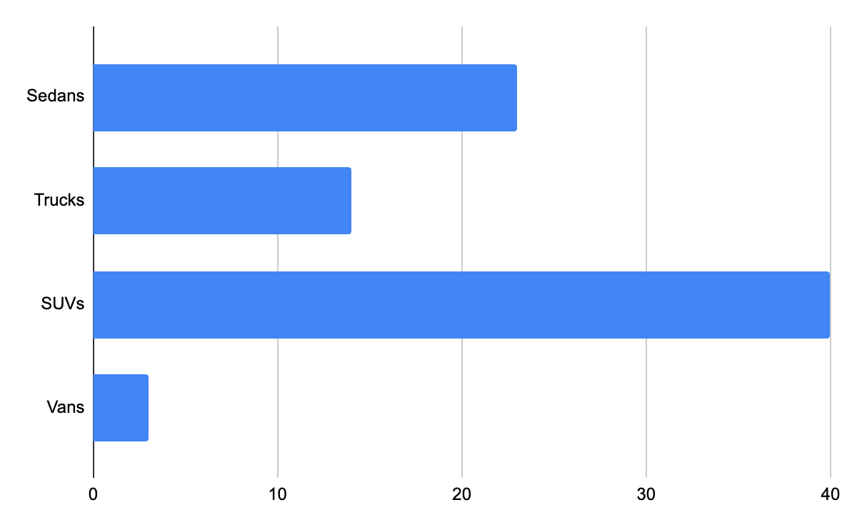
Visualizing Categorical Data: Bar Charts
Sedans | 23
Trucks | 14
SUVs | 40
Vans | 3

Slide 9
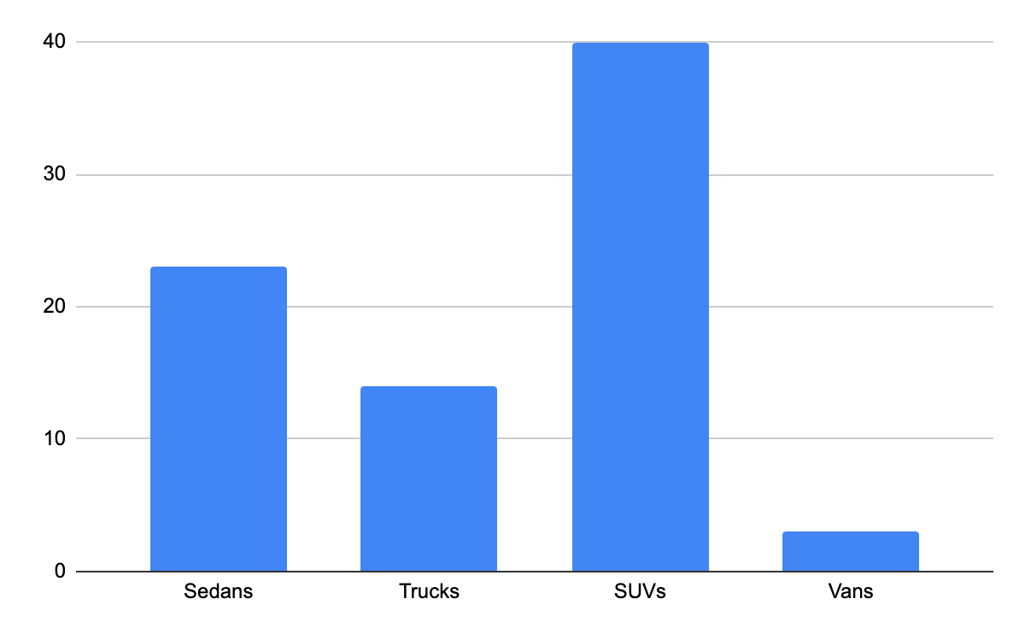
Visualizing Categorical Data: Column Charts
Sedans | 23
Trucks | 14
SUVs | 40
Vans | 3

Slide 10
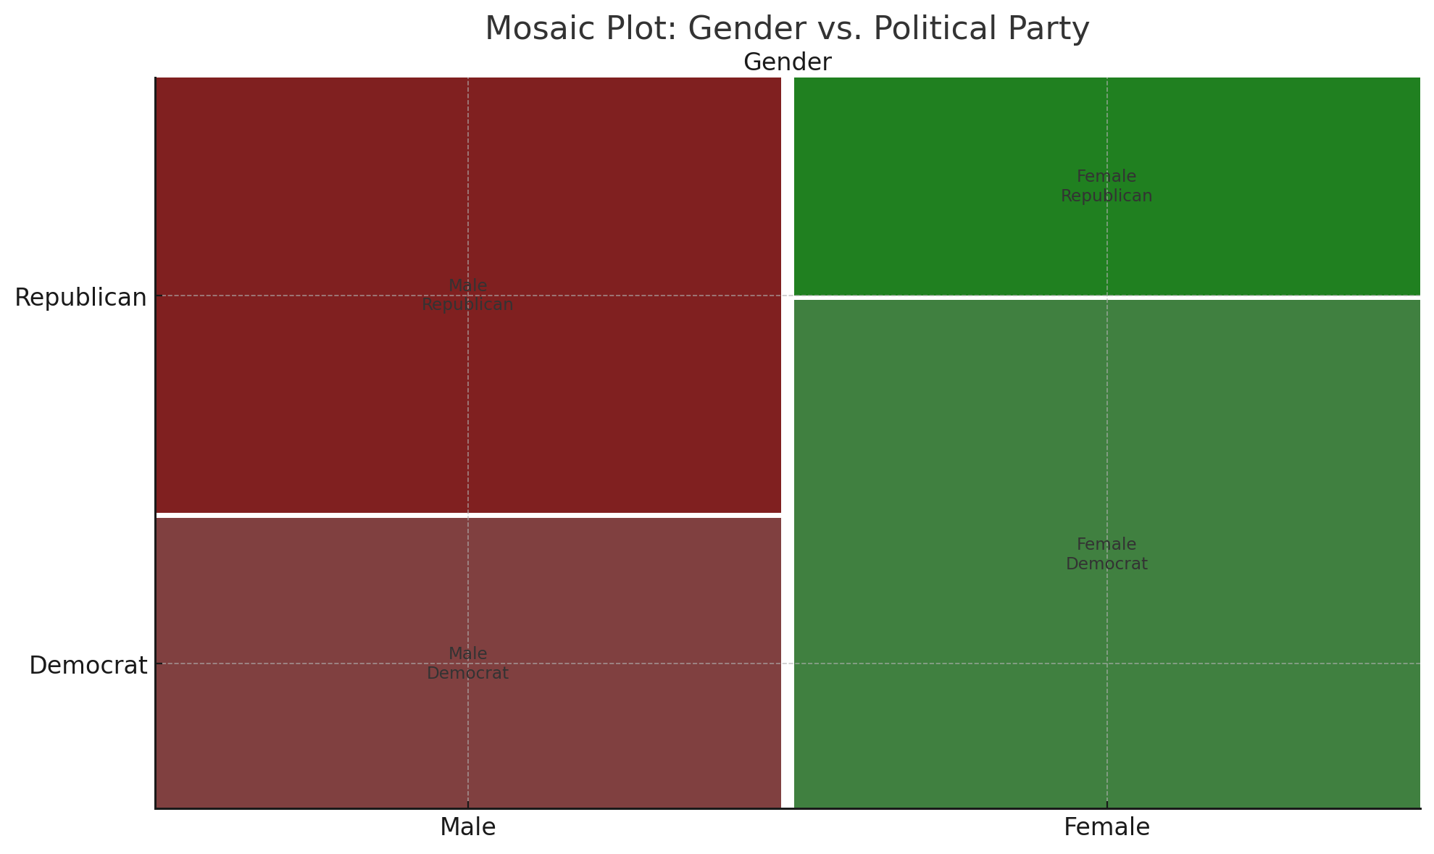
Mosaic Chart
Like a column chart where width and height reflect proportion of variables of multiple categorical variables
Shows joint and conditional proportions
Useful when you want to compare how one variable is distributed across the levels of another

Slide 11
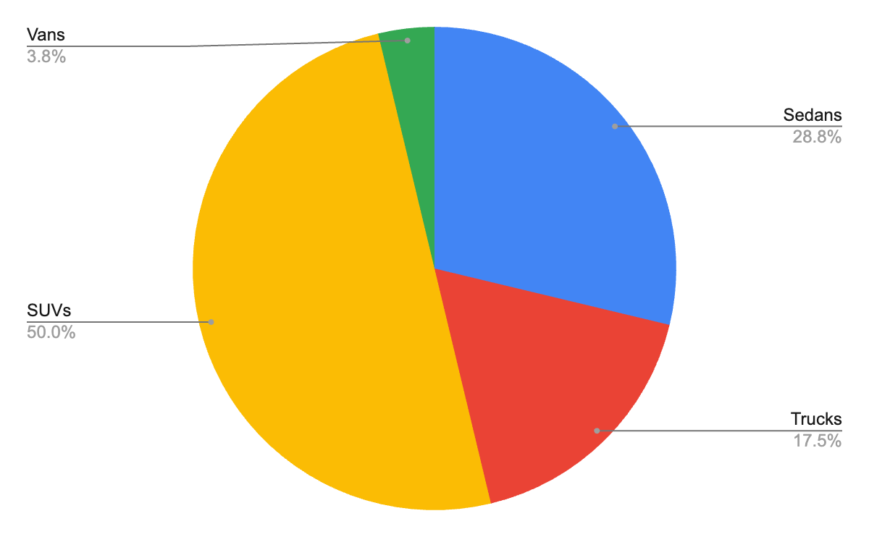
Visualizing Categorical Data: Pie Charts
Sedans | 23
Trucks | 14
SUVs | 40
Vans | 3
Useful for displaying the composition of a categorical variable

Slide 12
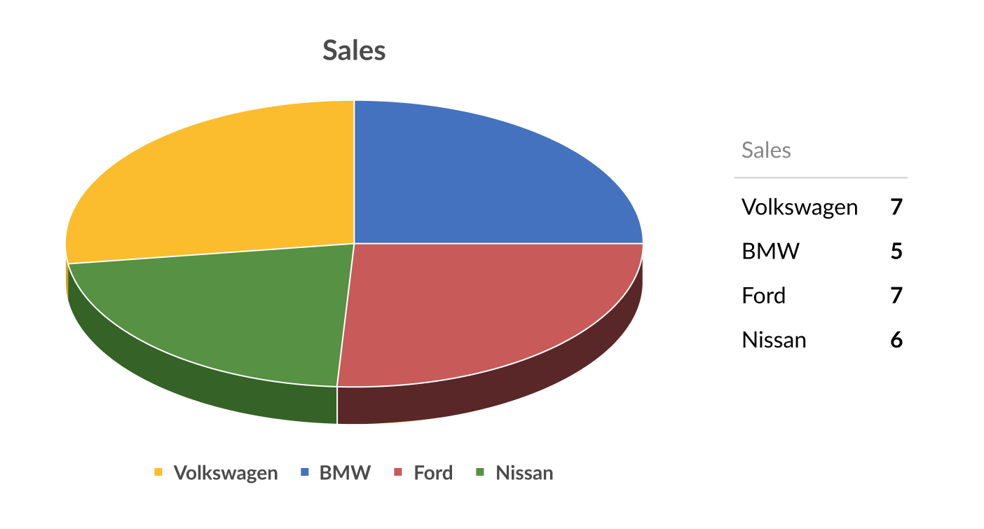
Bad Pie Charts
3D makes it hard to discern relative sizes of slices

Slide 13
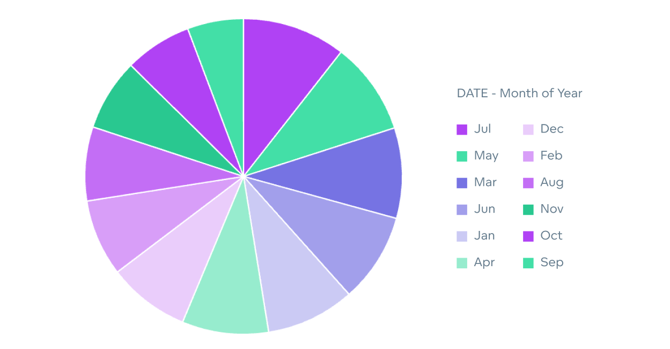
Bad Pie Charts
Too many slices / lack of labels make it hard to discern relative size of slices

Slide 14
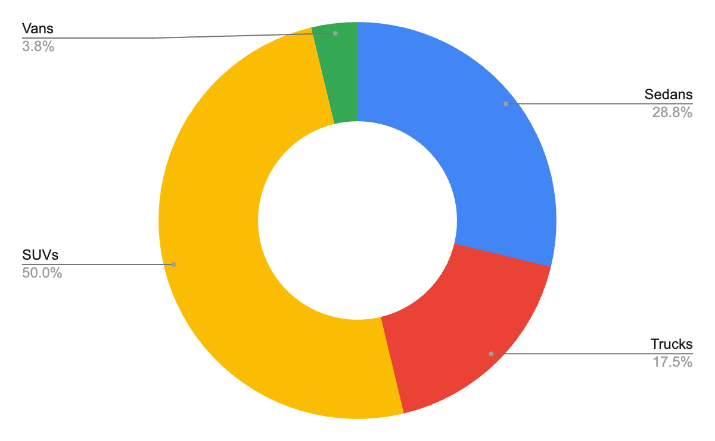
Visualizing Categorical Data: Donut Charts
Sedans | 23
Trucks | 14
SUVs | 40
Vans | 3

Slide 15
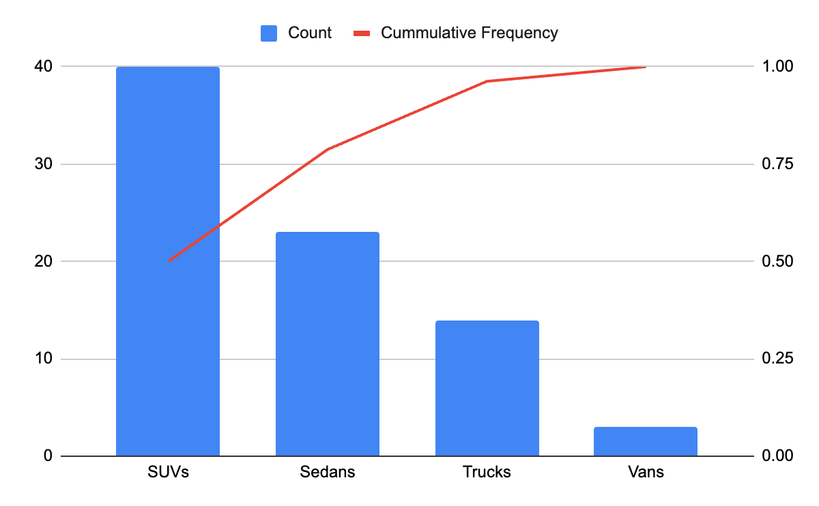
Visualizing Categorical Data: Pareto Charts
Sedans | 23
Trucks | 14
SUVs | 40
Vans | 3
Useful for detecting which categories are contributing most

Slide 16
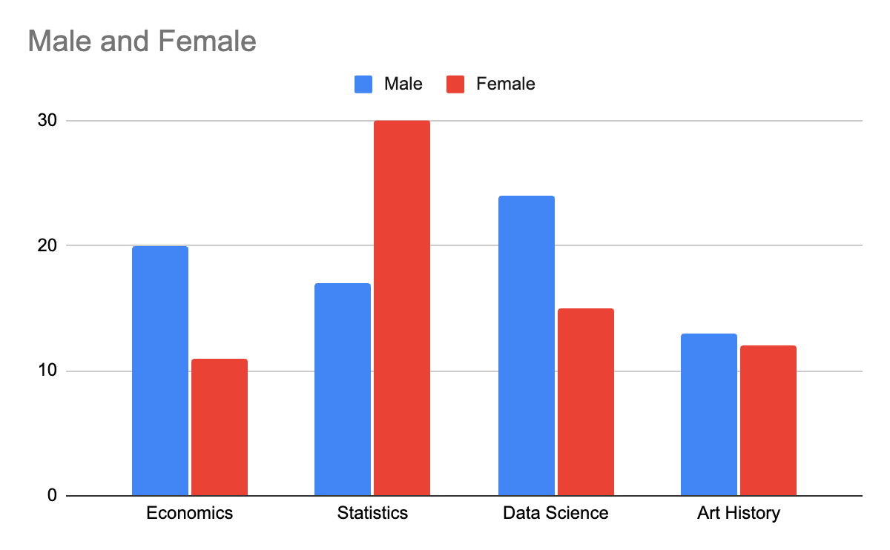
Visualizing Two Categorical Variables: Column Charts
 | Male | Female
Economics | 20 | 11
Statistics | 17 | 30
Data Science | 24 | 15
Art History | 13 | 12

Slide 17
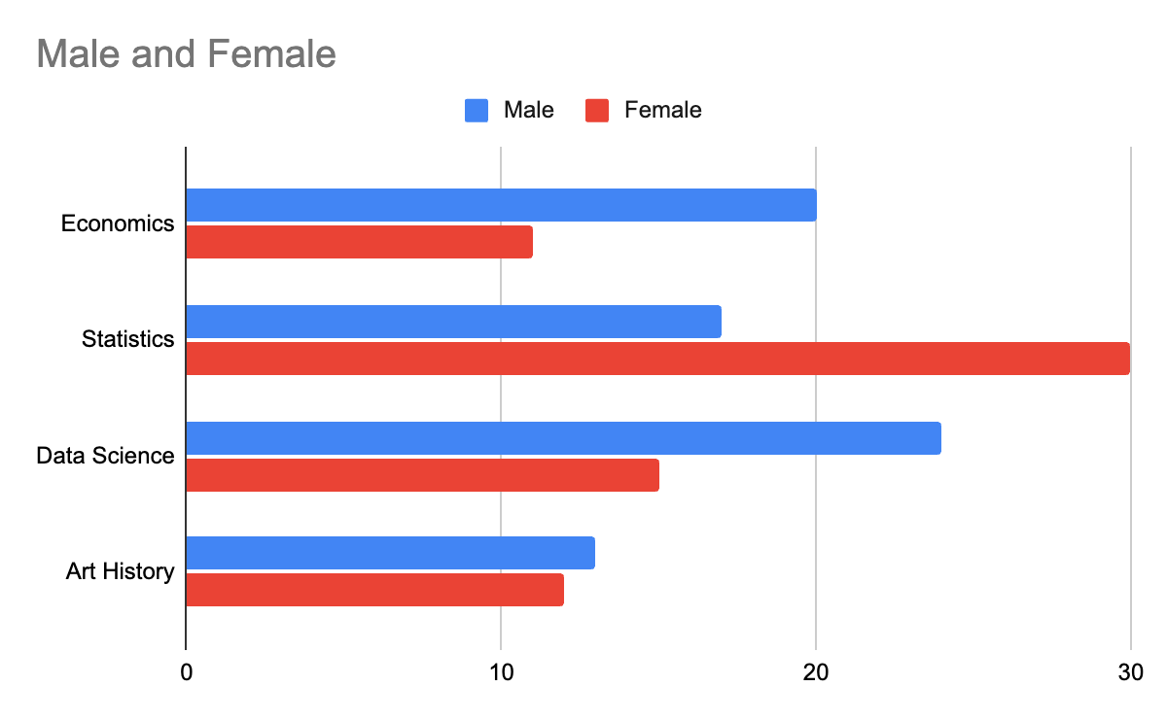
Visualizing Two Categorical Variables: Bar Charts
 | Male | Female
Economics | 20 | 11
Statistics | 17 | 30
Data Science | 24 | 15
Art History | 13 | 12

Slide 18
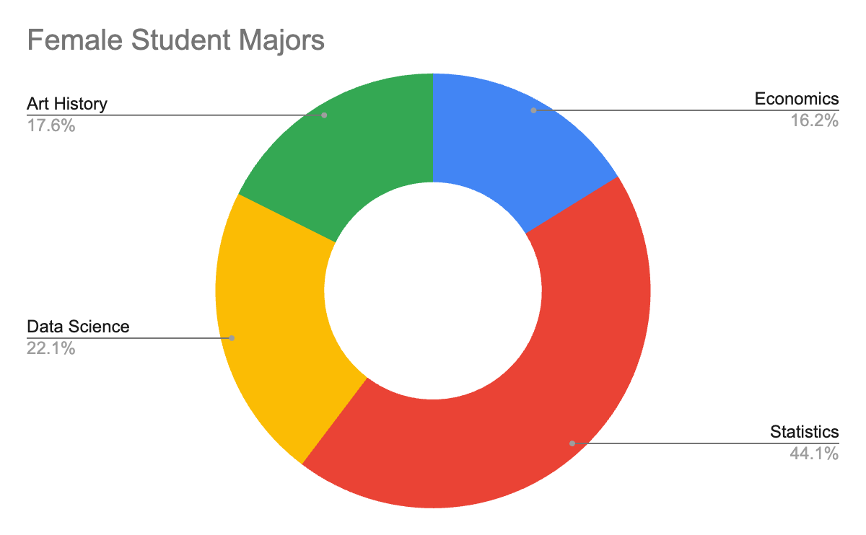
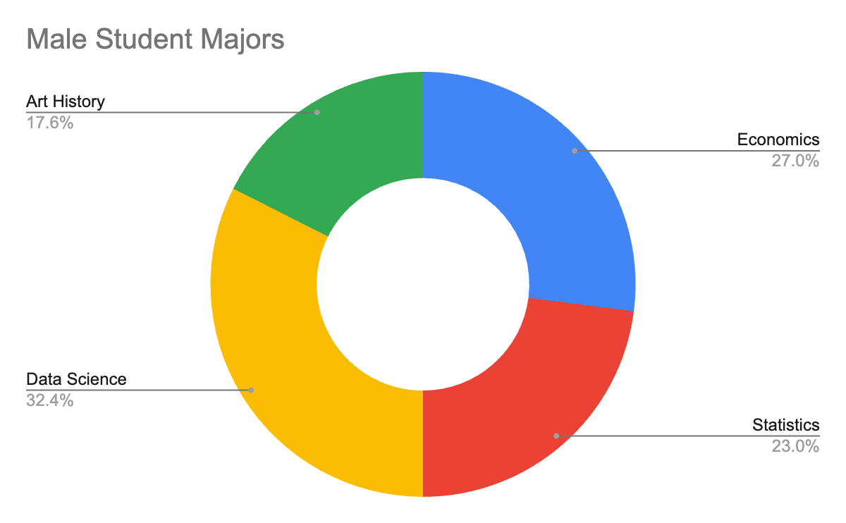
Visualizing Two Categorical Variables: Multiple Donut Charts
 | Male | Female
Economics | 20 | 11
Statistics | 17 | 30
Data Science | 24 | 15
Art History | 13 | 12

Slide 19
Variable Types & Measurement Scales: Quantitative / Numerical
Discrete or Continuous
Discrete if only using integers (counting numbers) / cannot be subdivided
Usually the resulting of counting
Example: Numbers rolled on dice, Number of students in a class, Number of home runs in a baseball game
Continuous if using numbers that can be meaningfully subdivided into smaller / finer levels
Usually the result of measuring
Example: Time taken during a project, speeds of cars, heights of individual people
Interval or Ratio
Interval: Numerical data with equal intervals between values but no “true” zero point
Ex: Calendar years, temperature, IQ
Note that the year zero isn’t actually the beginning of time and that zero degrees doesn’t mean zero heat (it’s just water’s freezing point)
Zero is selected, not a real property of what’s being measured.
Can only add and subtract, not multiply or divide interval data
Ratio: Numerical data with equal intervals and a true zero point
Ex: Incomes ($0, $20, $50k)
All arithmetic is valid for ratio data
Notes:
Adding and subtracting is fine with interval data, but multiplication / division are not. Adding and subtracting care about differences, multiplication and division care about origins and scale.
Take two temperatures: A = 20°C, B = 10°C. If ratios were meaningful, the ratio should survive a unit change.
In Celsius:
20 / 10 = 2 = “twice as hot” Now convert to Kelvin:
293 / 283 ≈ 1.035 The ratio changed.
That means the ratio was never a real property of the thing, just an artifact of where you put zero.

Slide 20
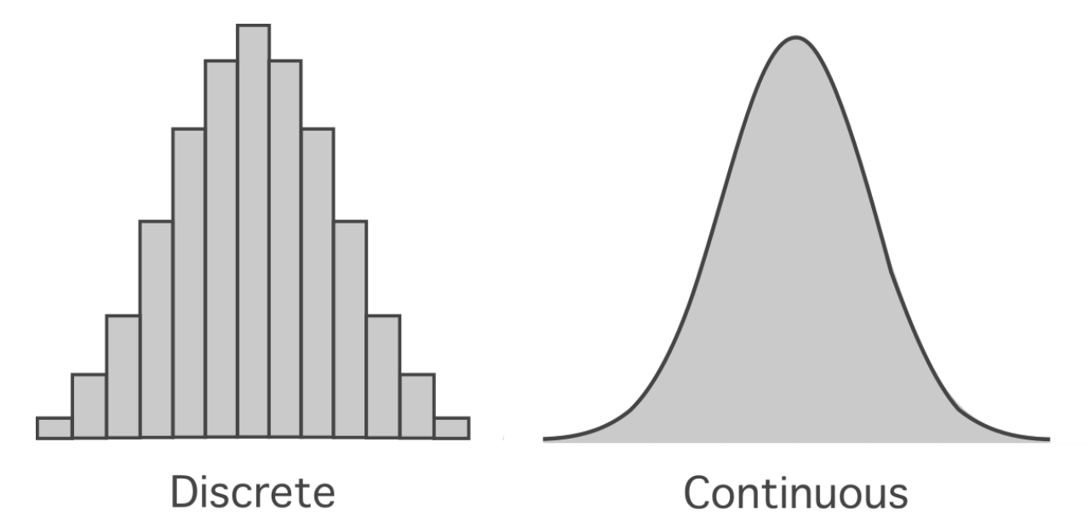
Discrete vs Continuous

Slide 21
Organizing Quantitative Data: Stem & Leaf Tables
Exam Grades:
68
65
79
87
92
89
67
81
90
Stem | Leaf
6 | 5 7 8
7 | 9
8 | 1 7
9 | 0
Something of a crude histogram.
Stem is typically everything but the last digit.

Slide 22
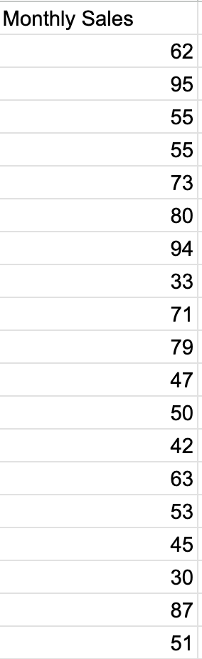
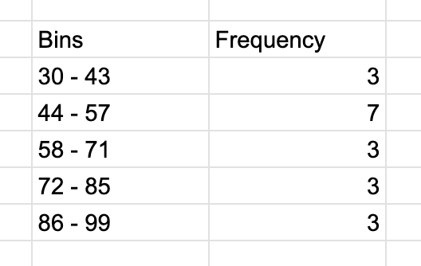
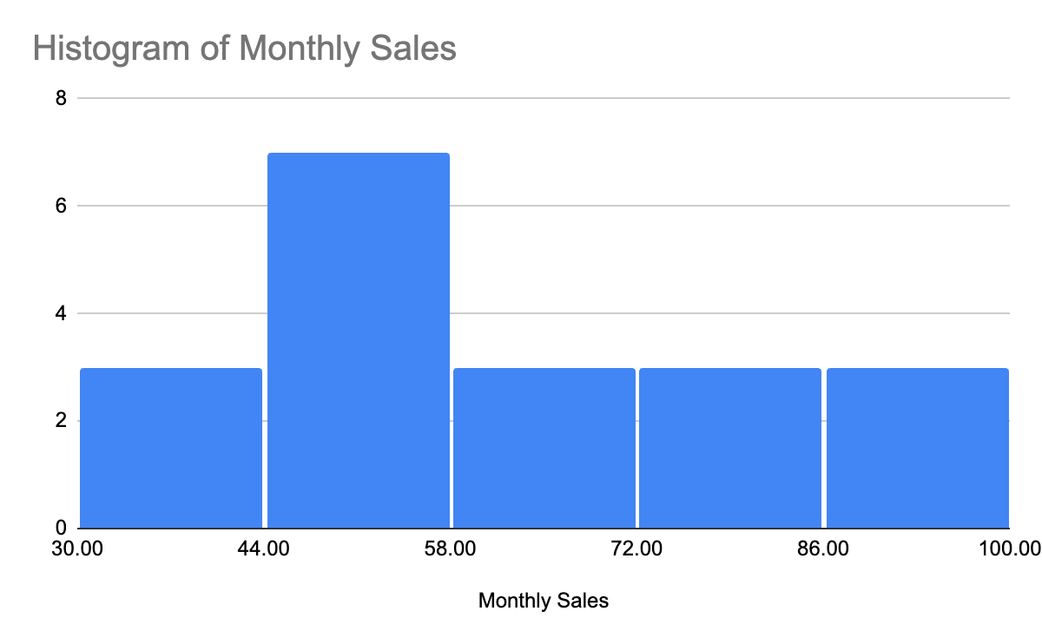
Visualizing Quantitative Data: Histograms
Similar to column charts - Height represents counts / frequency
Many uses*
How to make one:
Divide data into “bins” (typically between 5 and 20)*
Divide range of data (Max - Min) by bin count to get bin size / width
Example: If max = 95 and min = 30, range = 65. If five bins, bin width = 65/5 = 13
Assign observations to bins
Plot as columns
Try alternative bin widths and counts before drawing strong conclusions

Slide 23
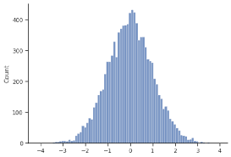
Histograms
Goal | How A Histogram Helps
Understand the shape of a distribution | Reveals whether data is normal, skewed, uniform, etc.
Detect clusters, gaps, or outliers | Makes unusual patterns or outliers easy to spot
Compare frequency of values across ranges | Shows how common different ranges of values are
Explore variability and spread | Wider distribution means more variability
Prepare for statistical modeling | Helps assess assumptions like normality for regression or tests

Slide 24
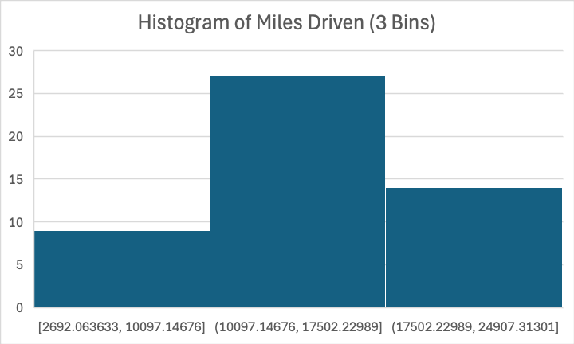
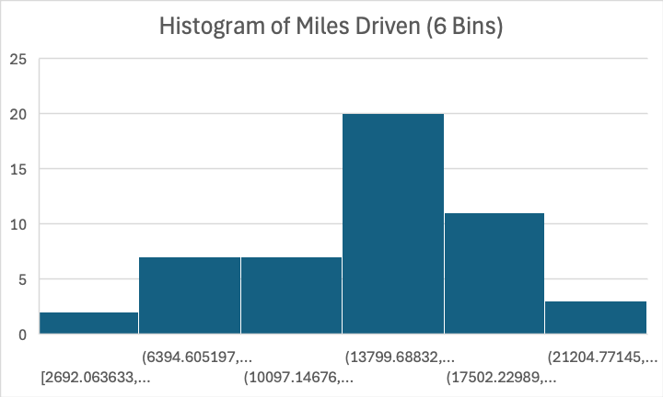
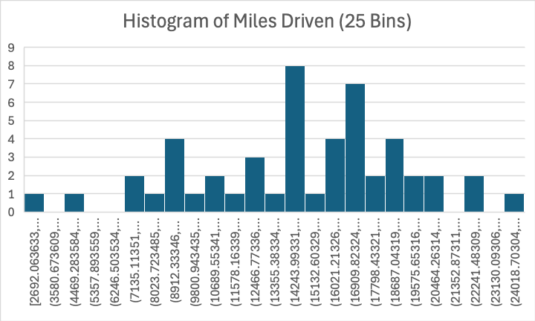
Bin Count
Too few: Oversimplified, hides important structures (bimodality, clusters, etc.)
Too many: Random variation looks like real patterns, overinterpreting noise

Slide 25
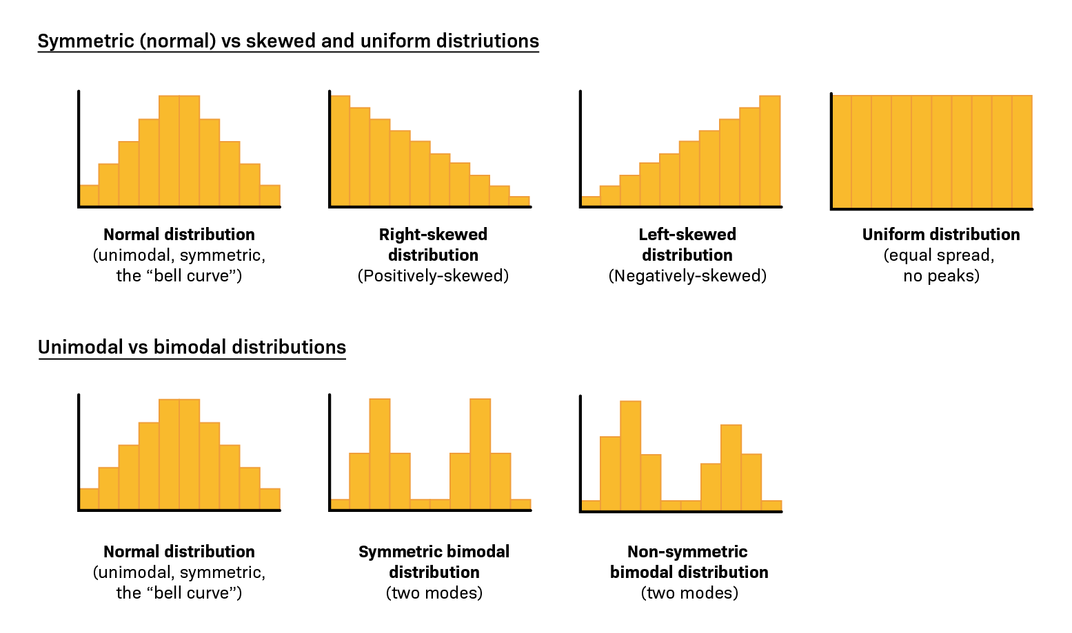
Histograms (continued)

Slide 26
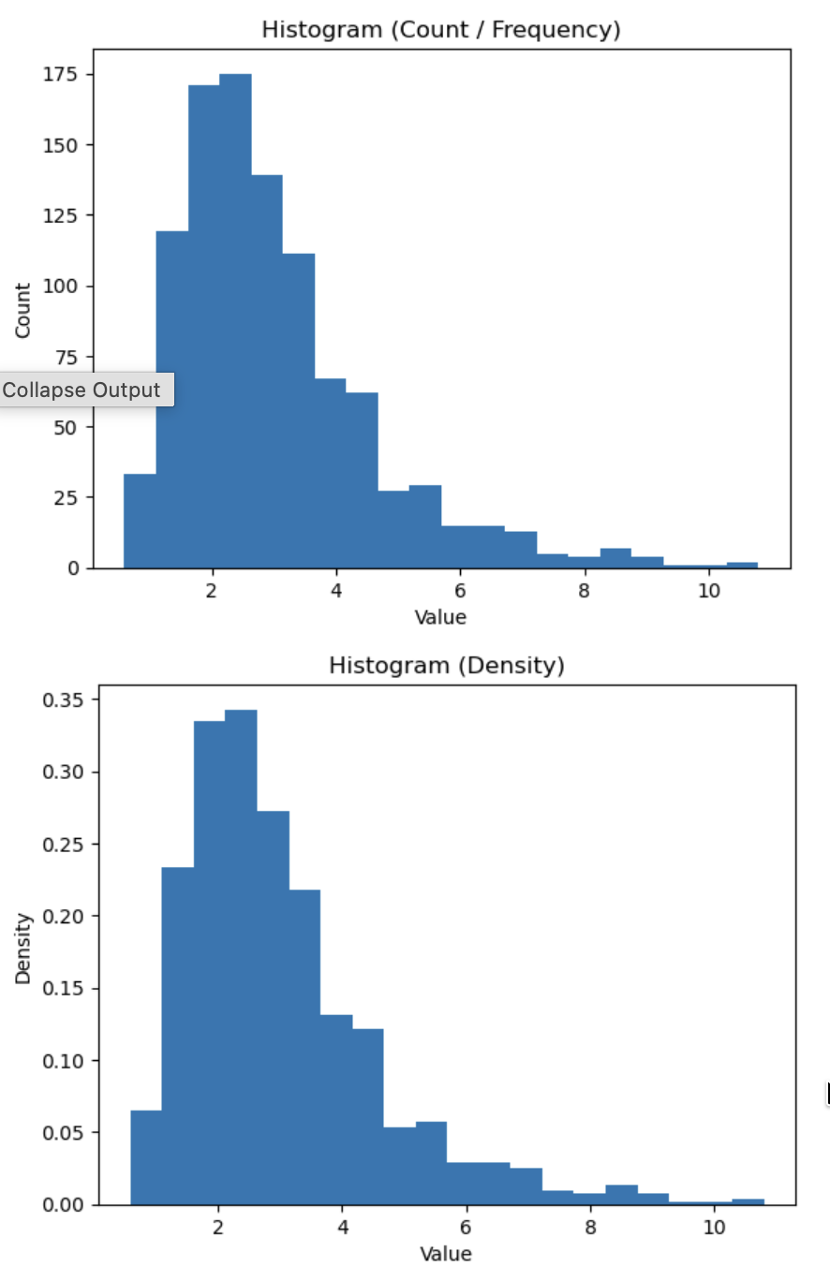
Count vs Density Histograms
Count:
Y-axis = Number of observations
Area depends on sample size
Frequency
Y-axis = Probability density
Area sums to 1
Frequency is better for comparing distributions / shape across datasets

Slide 27
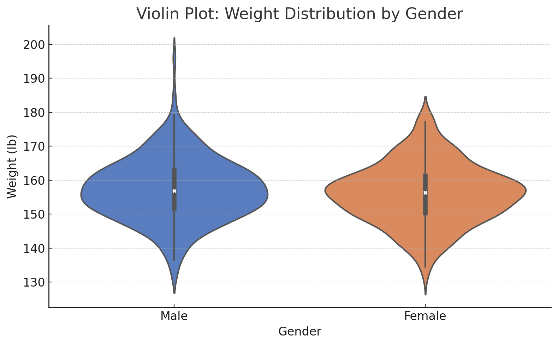
Violin Plot
Width = frequency
White dot = median
Thick black bar = IQR
Thin black line = min and max, excluding outliers beyond 1.25x IQR

Slide 28
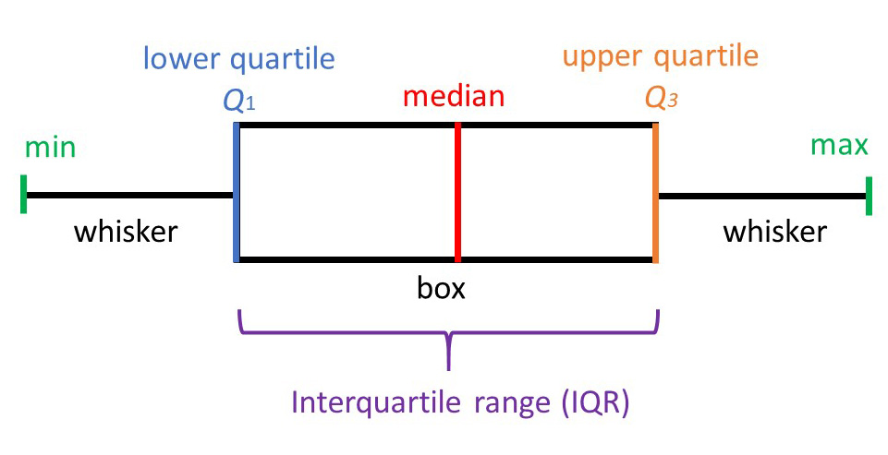
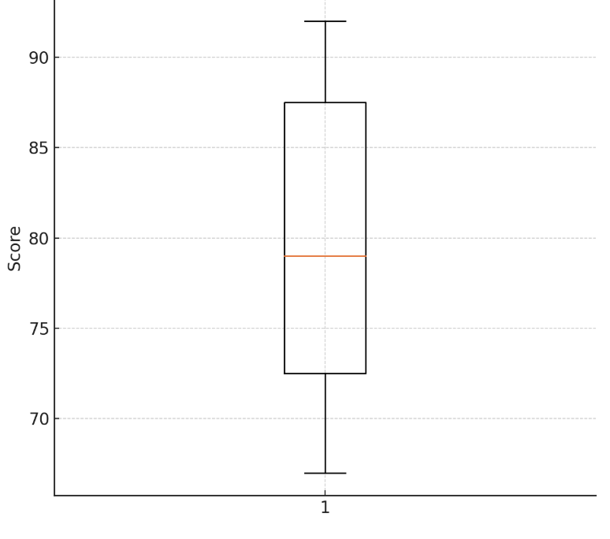
Visualizing Quantitative Data: Box and Whisker Plots

Slide 29
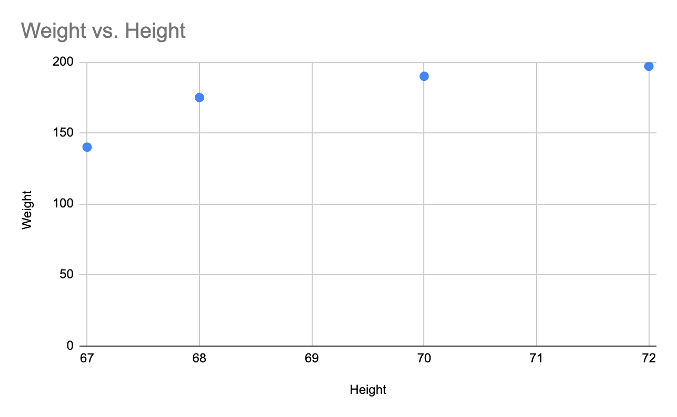
Visualizing Two Numerical Variables: Scatter Plots
Plot coordinate pairs of two variables
Height | Weight
67 | 140
68 | 175
70 | 190
72 | 197

Slide 30
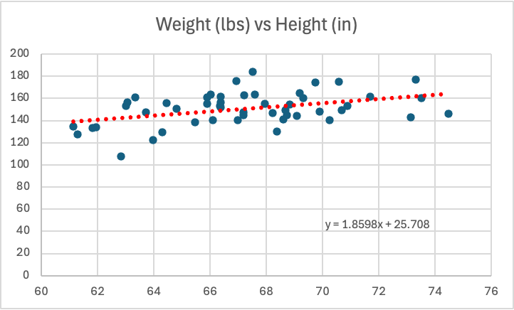
Scatter Plot with Trend Line
Adding a trend line can help clarify the relationship
Equation of line can be displayed as well to provide a more mathematically precise description of the relationship (y = mx + b style)
Tends to imply causation…

Slide 31
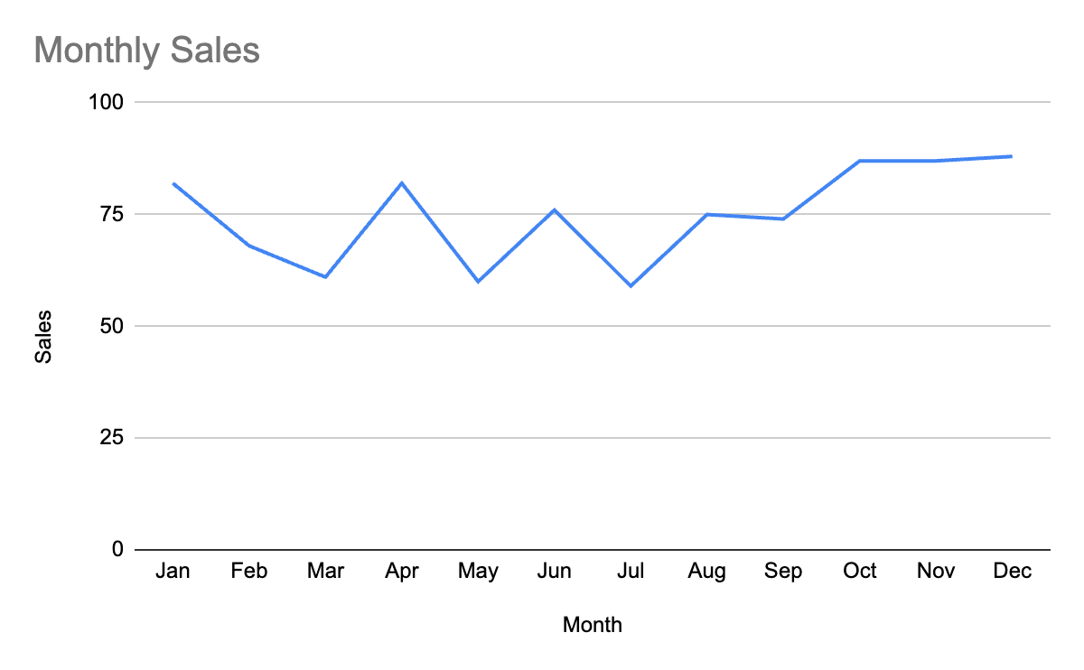
Visualizing Numerical Data - Time Series / Line Charts
Month | Sales
Jan | 82
Feb | 68
Mar | 61
Apr | 82
May | 60
Jun | 76
Jul | 59
Aug | 75
Sep | 74
Oct | 87
Nov | 87
Dec | 88

Slide 32
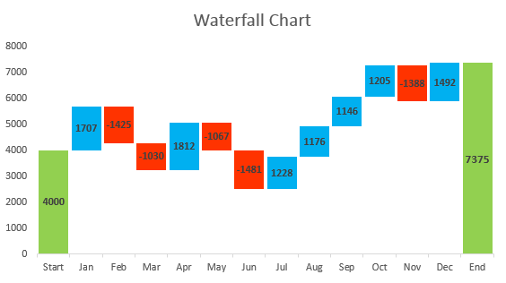
Waterfall Chart
Illustrates impact of changes based on categories or time period
Each bar builds upon last
Illustrates individual contributions
Final bar shows cumulative outcome

Slide 33
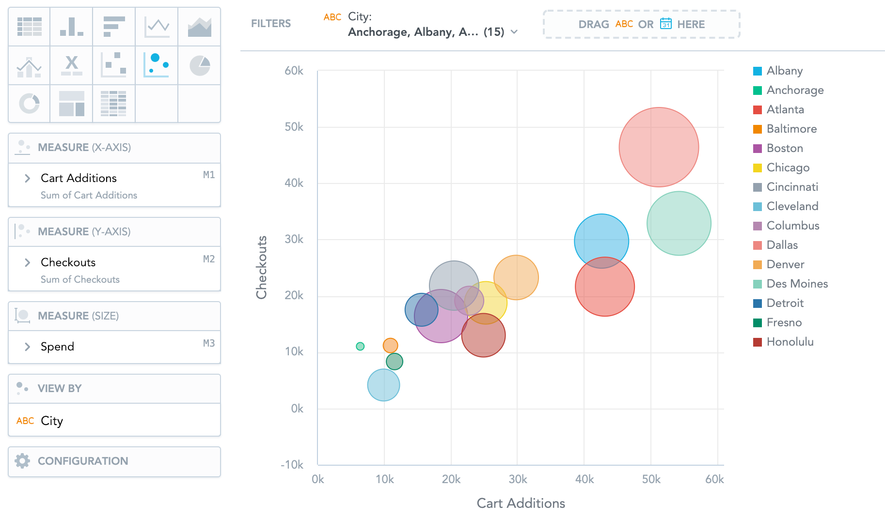
Visualizing Three Or More Variables: Bubble Charts
X and Y values go on the X and Y axes, respectively
A third variable, Z, is related to the size of the bubble
Color of bubbles could indicate another categorical or continuous variable
Remember: Just because you can, doesn’t mean you should…

Slide 34
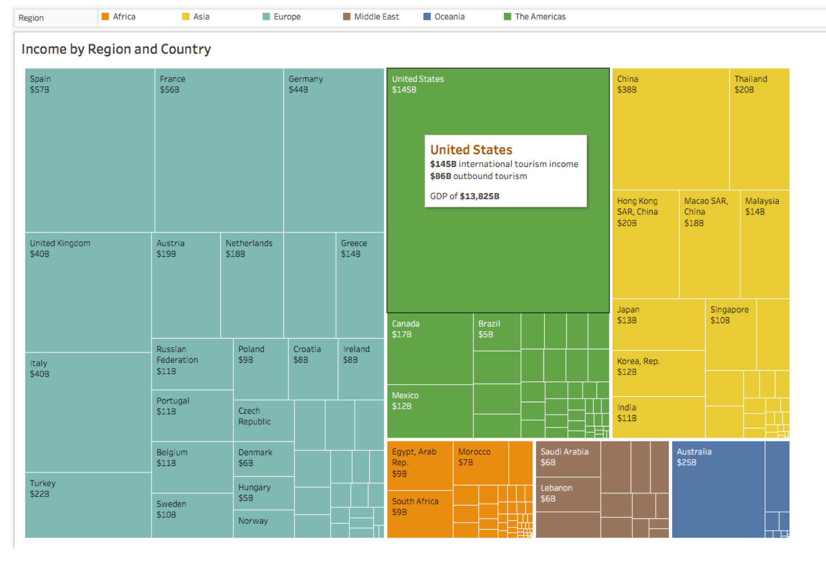
Tree Map
Area of squares shows relative magnitude of each category

Slide 35
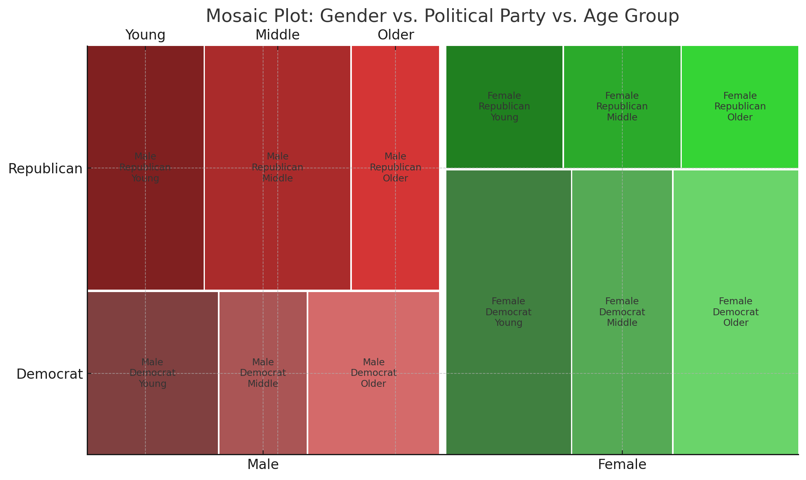
Mosaic Chart w/ 3 Variables

Slide 36
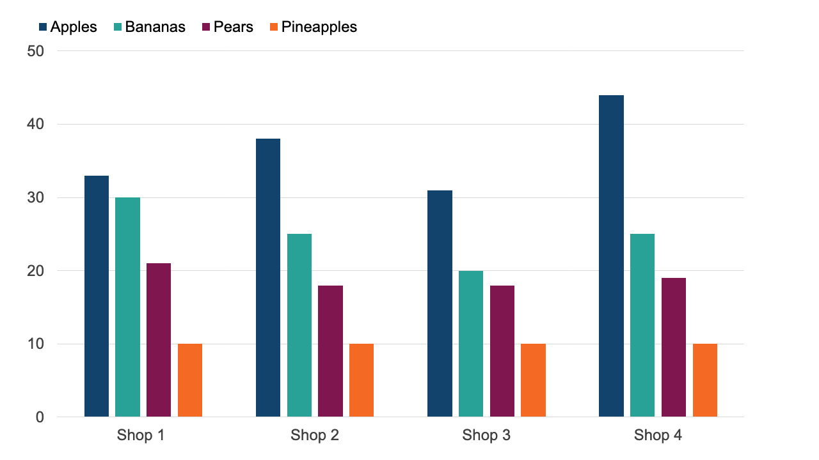
Clustered Column Chart

Slide 37
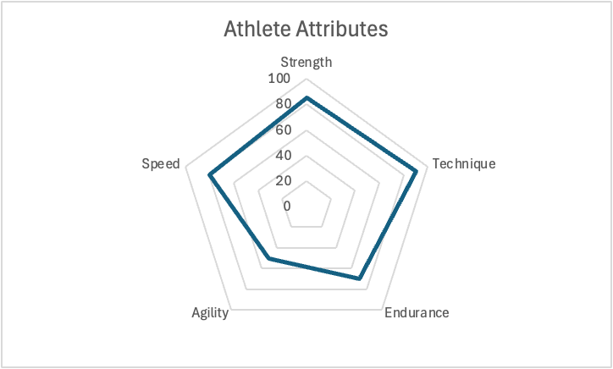
Radar Chart
Displays multivariate data in a circular layout to compare multiple quantitative categories
Good for showing strengths and weaknesses
Area covered = overall profile

Slide 38
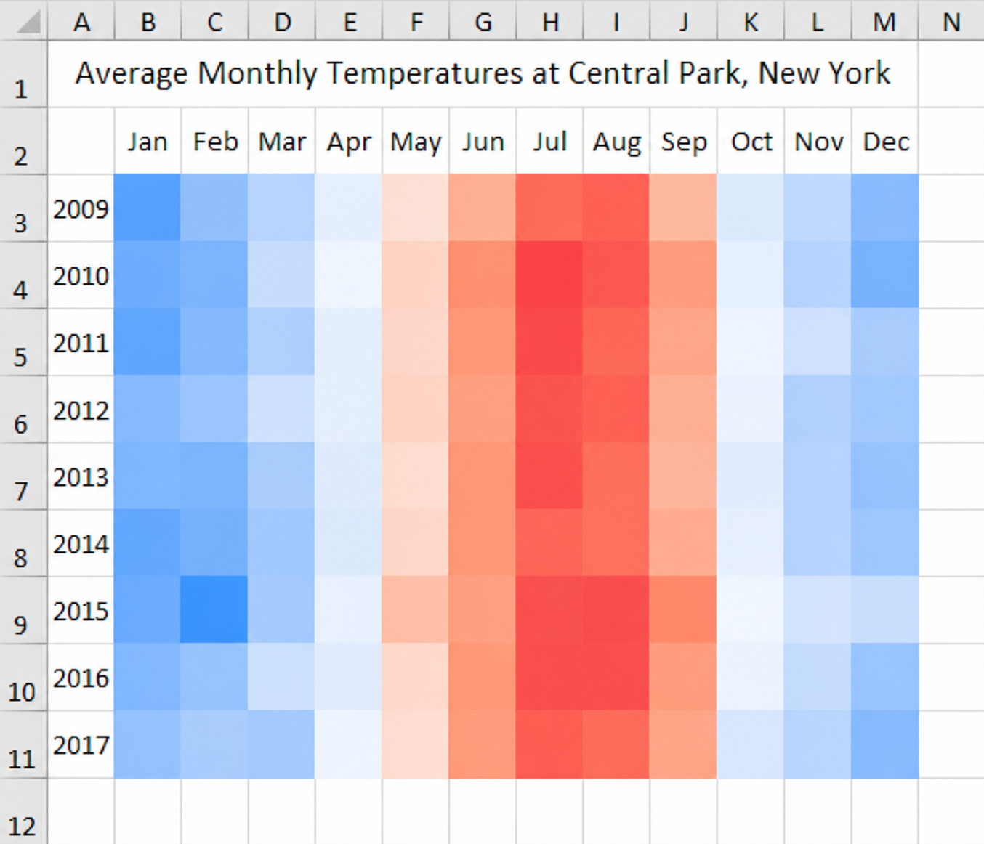
Heat Maps
Color of segment indicates direction and/or magnitude
Can be configured all sorts of ways

Slide 39
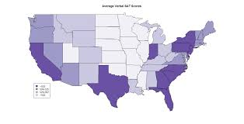
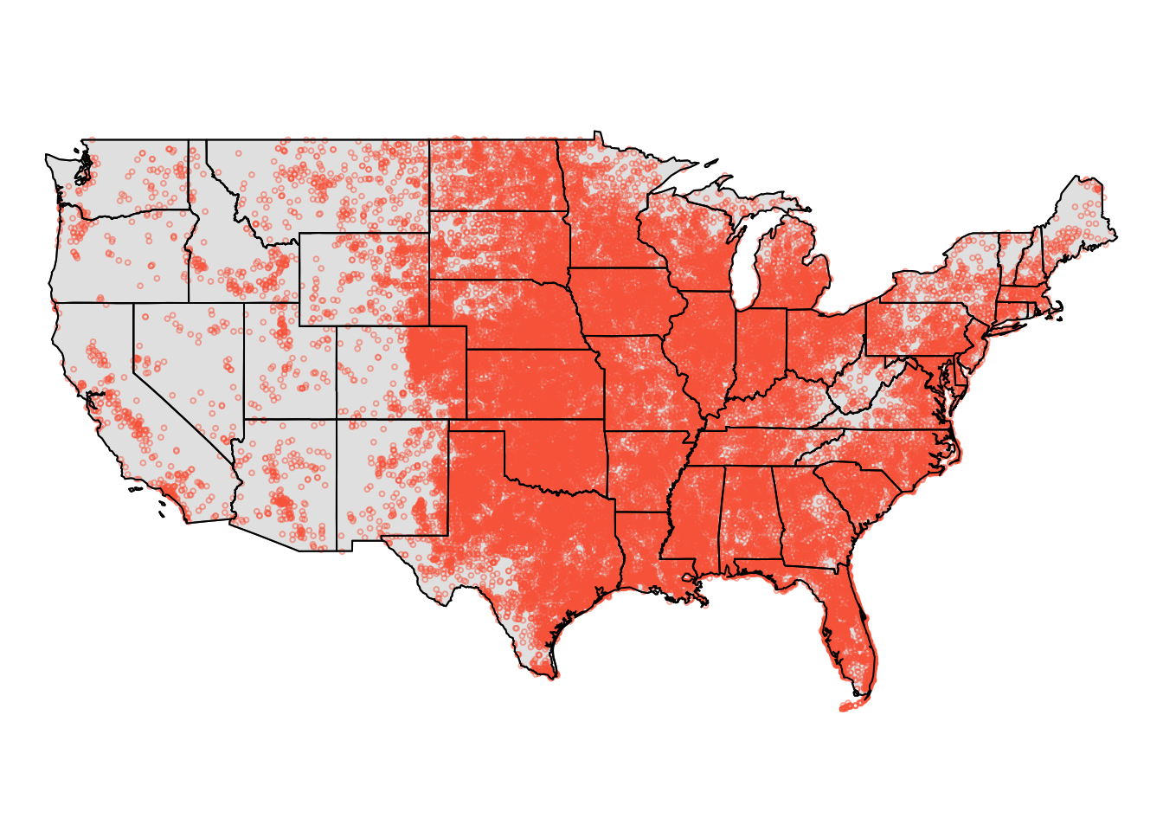
Spatial Data
Spatial data: Data with a location component
Data added to map as labels, points, colors, etc.
Sometimes called “geospatial” or GIS

Slide 40
Which chart/table should you use?
Variable Type(s) | Organization Method | Visualization Options | Notes
One Categorical | Frequency Table | Bar Chart, Pie Chart, Donut Chart, Pareto | Pareto = sorted bar chart by frequency
Two Categorical | Contingency Table | Clustered Bar Chart, Stacked Column, Mosaic | Use percentages based on rows, columns, or total
One Numerical | Frequency Distribution Table | Histogram, Box Plot, Stem-and-Leaf Plot | Histogram = for grouped bins; Box plot shows spread and outliers
Two Numerical | List of (x, y) pairs | Scatter Plot, Line Chart (if time series) | Shows relationships or trends over time
Numerical + Categorical | Grouped summaries (mean, etc) | Box Plot by Category, Side-by-side Histogram | Use group comparisons
Three or More Variables | Multi-dimensional table | Bubble Chart, Treemap, Heatmap, Multiple Axes | Use with caution — avoid visual overload
Time Series (1 variable) | Chronological table | Line Chart | Data must be continuous and ordered by time
Spatial Data | Map Table with coordinates | Heatmap on Map, Choropleth, Dot Density Map | Requires GIS or mapping software

Slide 41
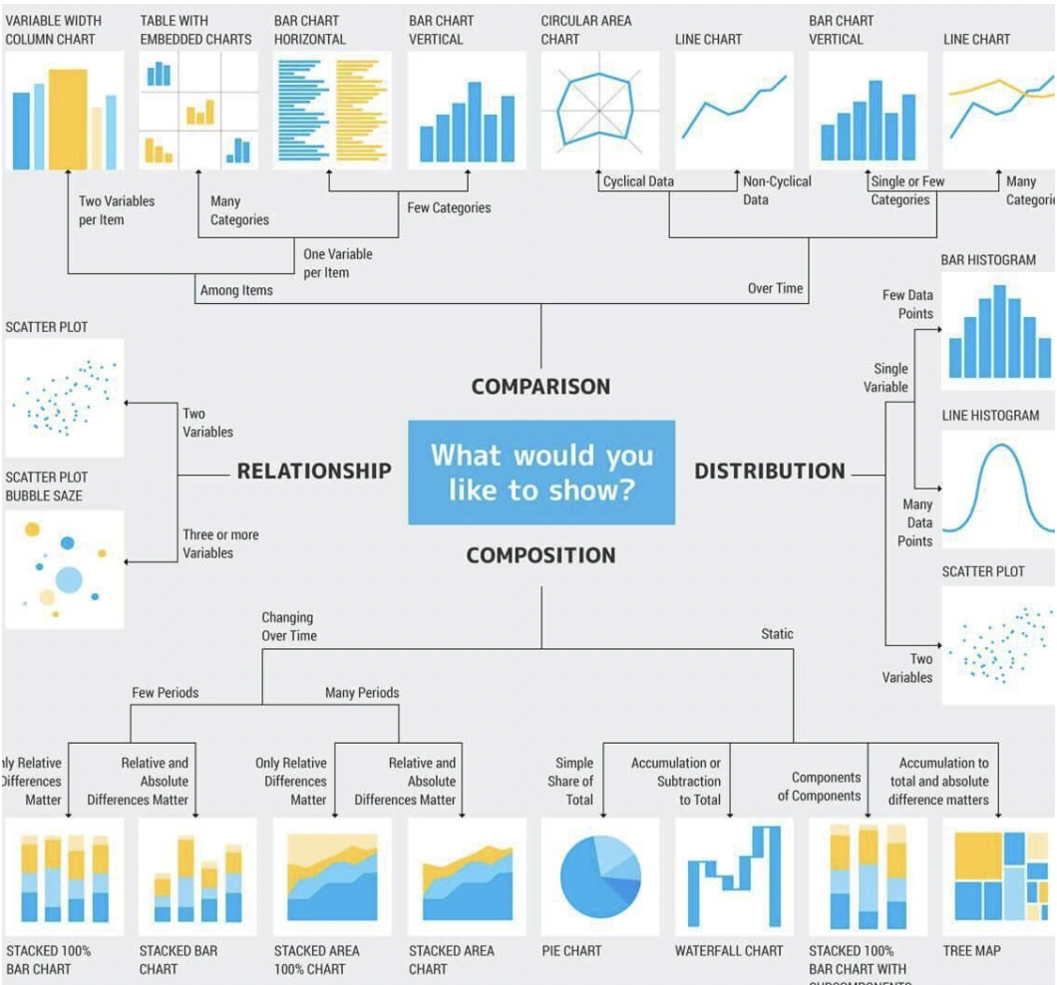

Slide 42
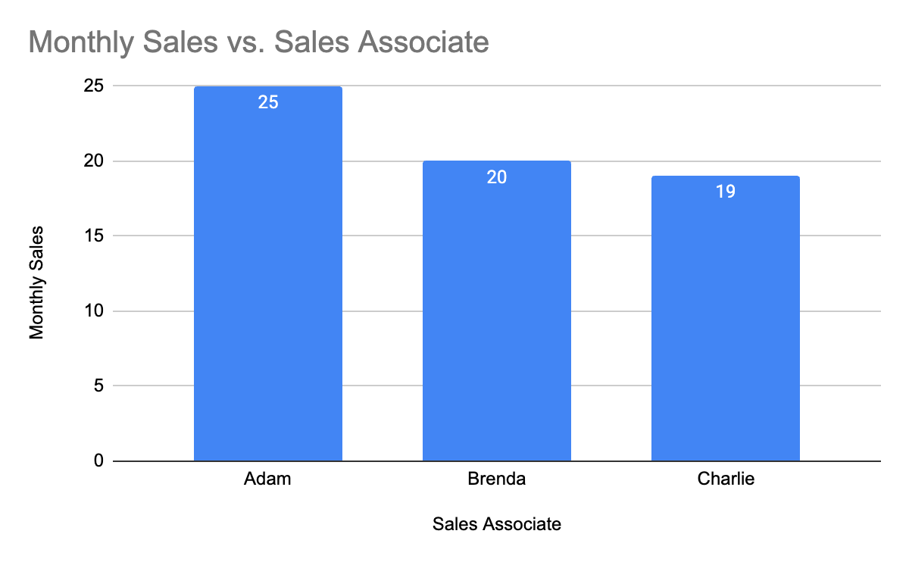
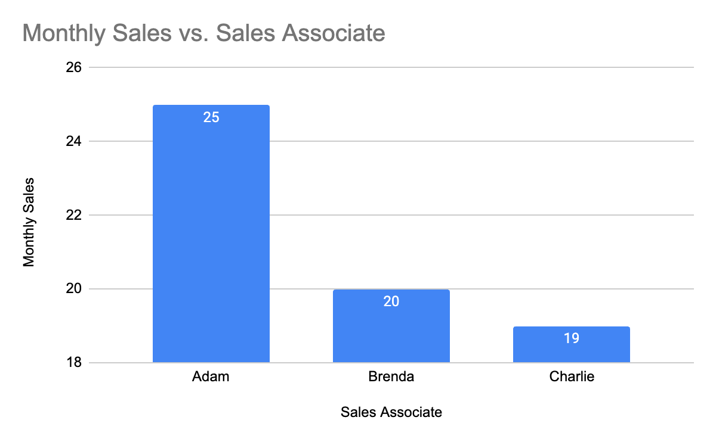
How To Lie With Statistics:
Mess With The Y Axis!

Slide 43
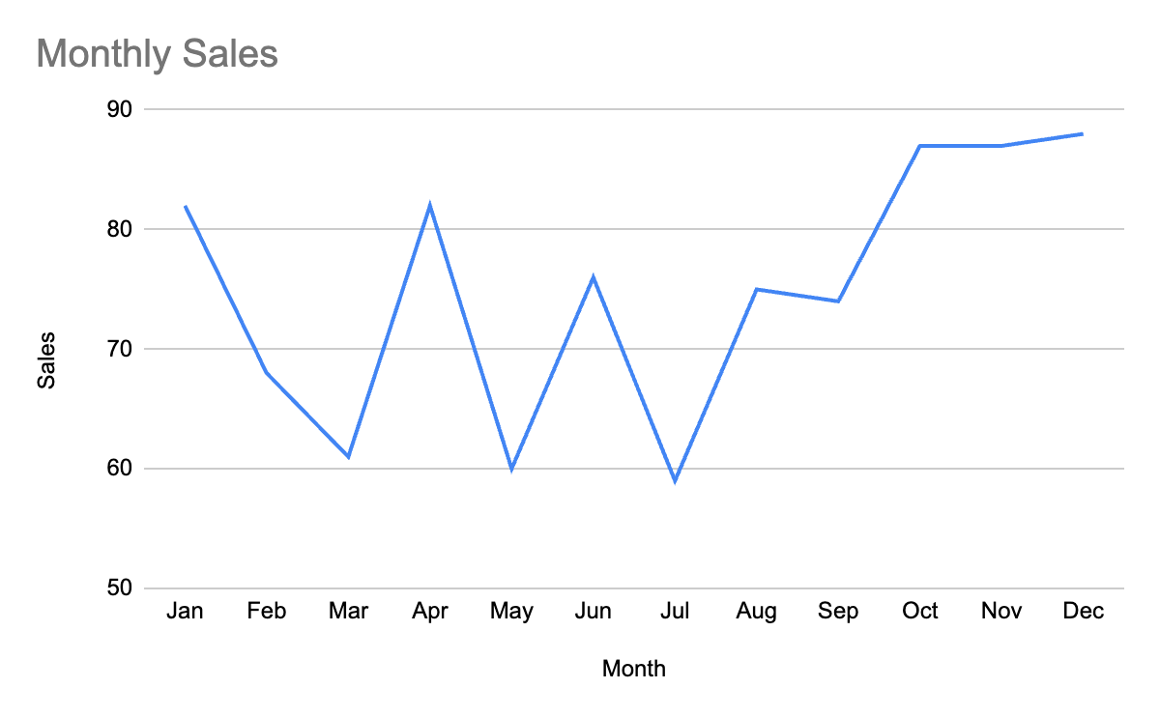
How To Lie With Statistics:
Mess With The Y Axis!

Slide 44
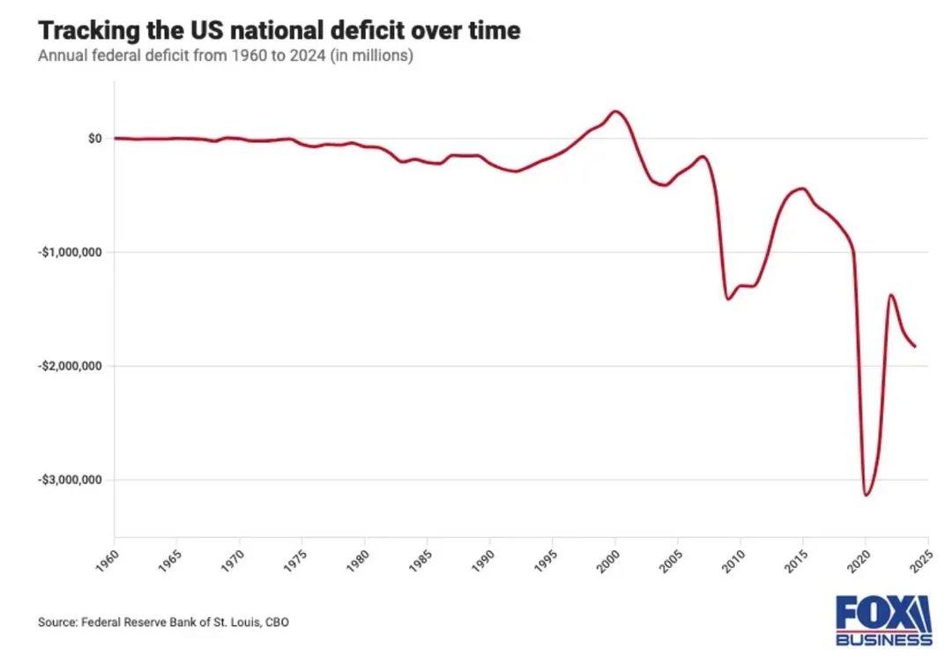
How To Lie With Statistics: Mess With The Y Axis!
Should this really be inverted?
This makes it look like it’s improving when it’s worsening!
It also should be as a percentage of GDP or inflation adjusted*

Slide 45
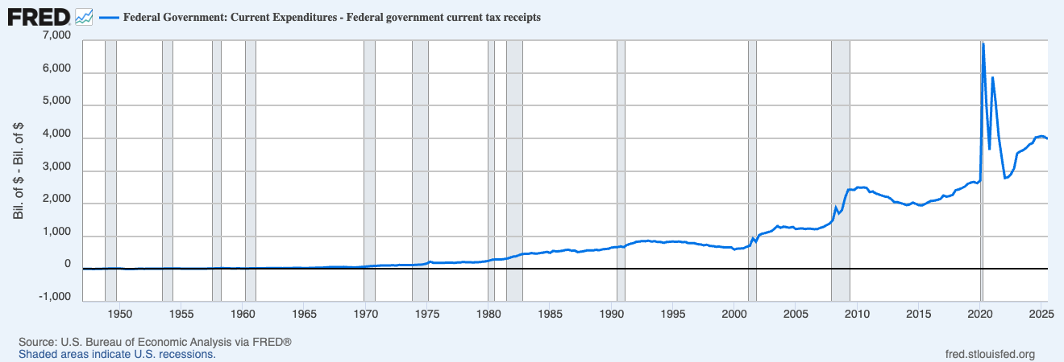
The actual deficit (Spending - Taxes)
Flipping the axis tells the proper story…a rising deficit, not a falling one!

Slide 46
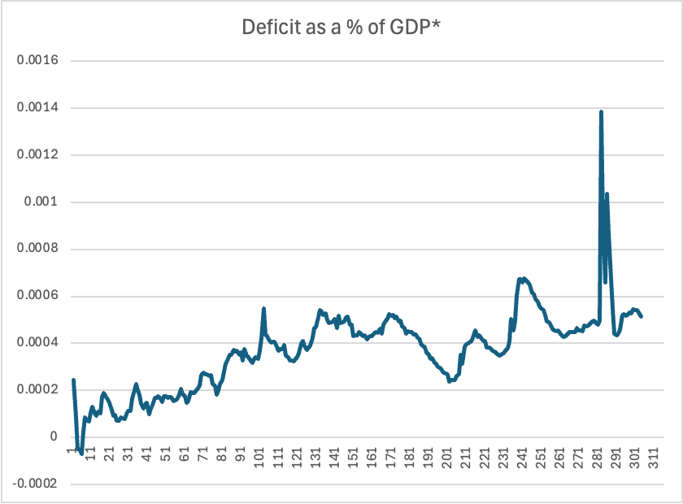
The actual deficit (as a %* of GDP)
Dividing by GDP effectively adjusts for inflation.
Instead of lower past prices making deficit look tiny in the past, each deficit is divided by that year’s nominal GDP

Slide 47
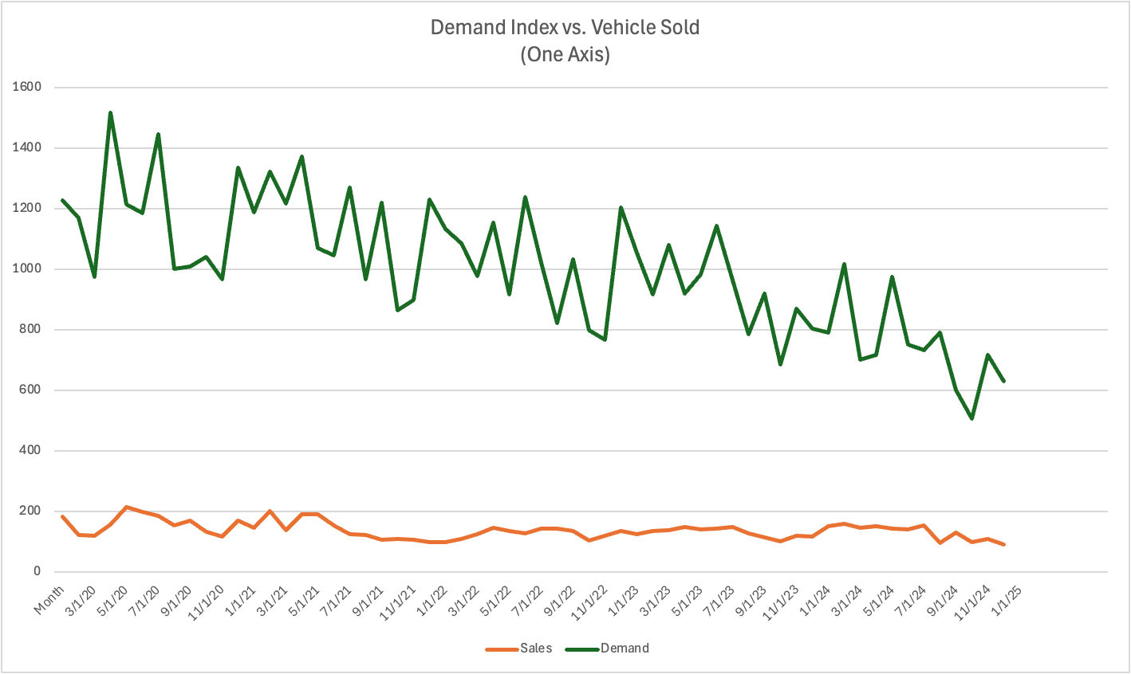
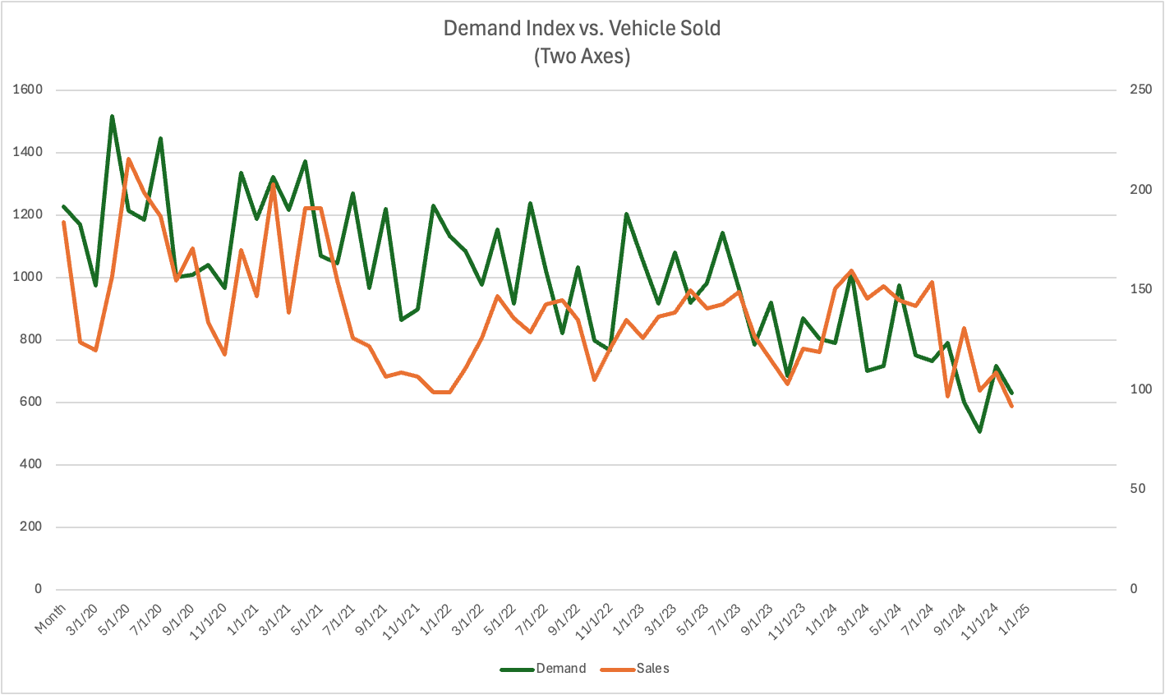
How to Lie With Statistics: Abuse Multiple Axes
When displaying two pieces of data on one chart, it is valid to use multiple axes if the units aren’t the same or the scale is different, but this may also imply causality

Slide 48
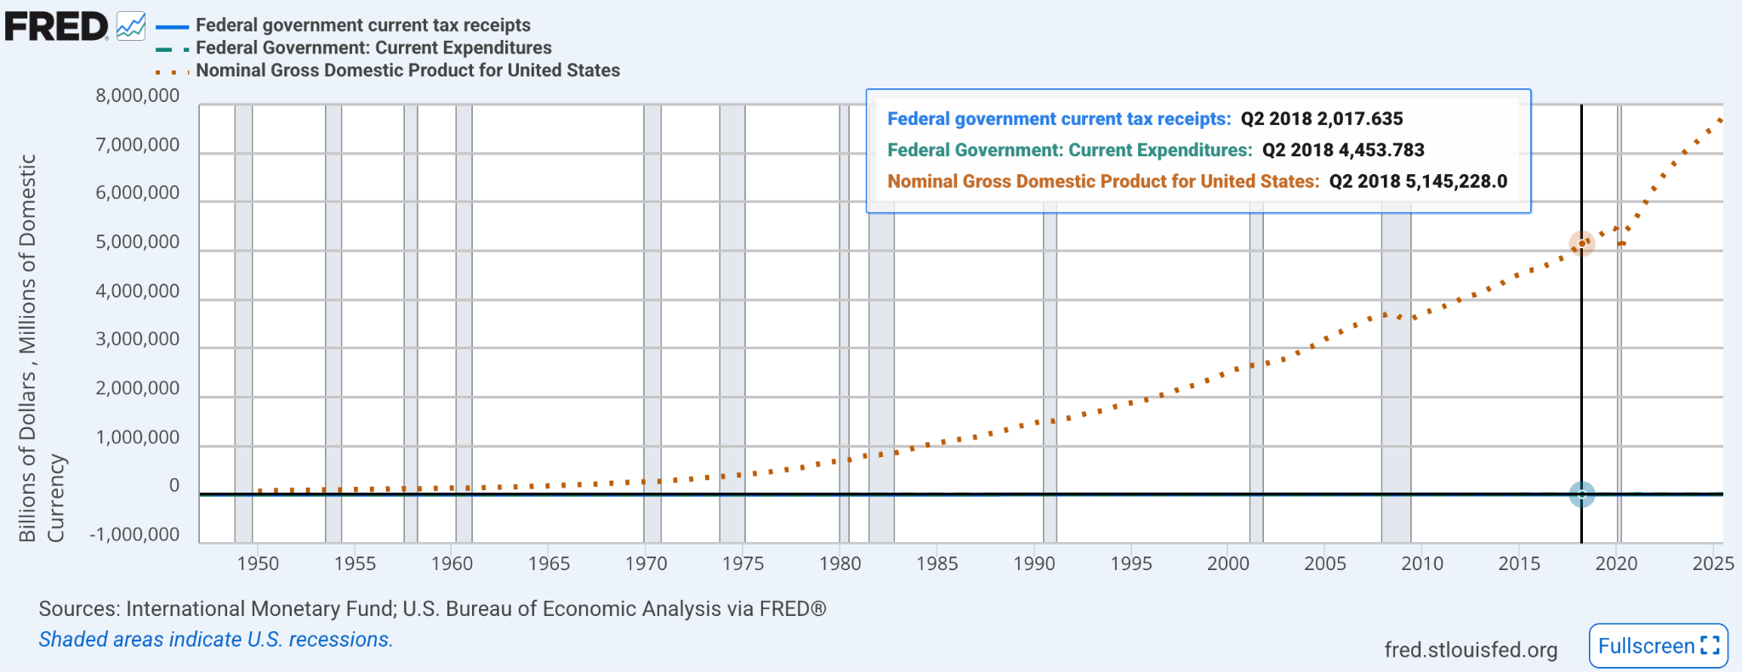
Scale Matters!

Slide 49
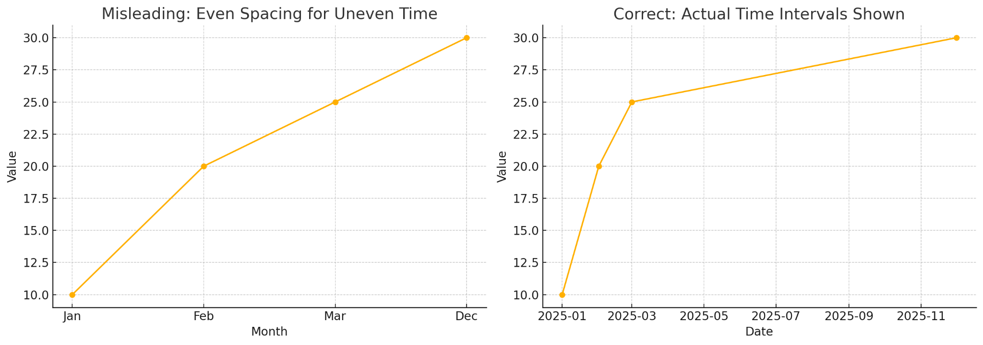
How to Lie With Statistics: Uneven Intervals

Slide 50
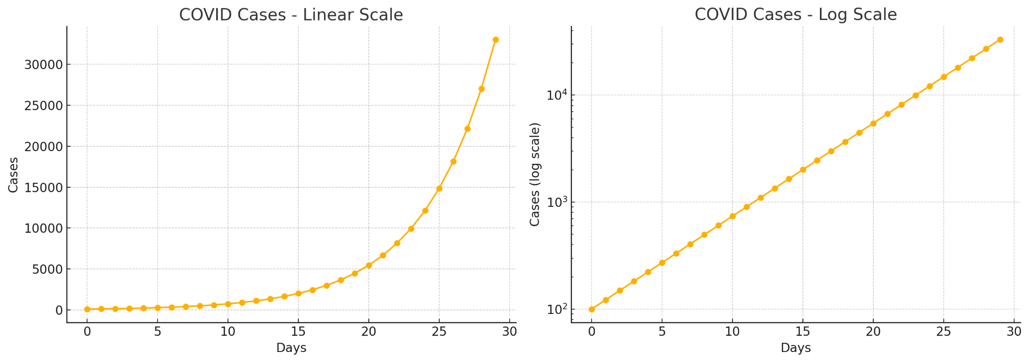
How to Lie With Statistics: Scaling

Slide 51
Summary / Visualization Best Practices
Taylor to your audience
Use the simplest method that works to tell the story you’re trying to tell
Label your chart and all axes
Begin the axes at zero
Use a consistent scale for the axes
Avoid 3D charts and other esoteric styles (radar, bubble, cone, etc.)
Avoid clutter and information overload
Pick color coding carefully / don’t color code if no good reason to do so
Consider labeling data points
Don’t put too many variables on a single graphic
Consider accessibility (high contrast, avoid red/green, use textures, etc.)

Slide 52
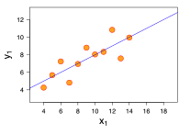


Anscombe's Quartet

Slide 53


Slide 54

Anscombe's Quartet

Slide 55
Assorted Links
https://cscheid.net/courses/fal16/cs444/demos/anscombes_trex.html
https://www.reddit.com/r/dataisbeautiful/
https://www.reddit.com/r/dataisugly/
https://viz.wtf/

Slide 56
Key lesson of Anscombe's Quartet: Visualizing data is a critical part of analysis, not just for fun, aesthetics, and/or showing others!!!

Slide 57


Slide 58


